Slide 1
Outcomes of LSV-PPP

Slide 2
Overview
1

Slide 3
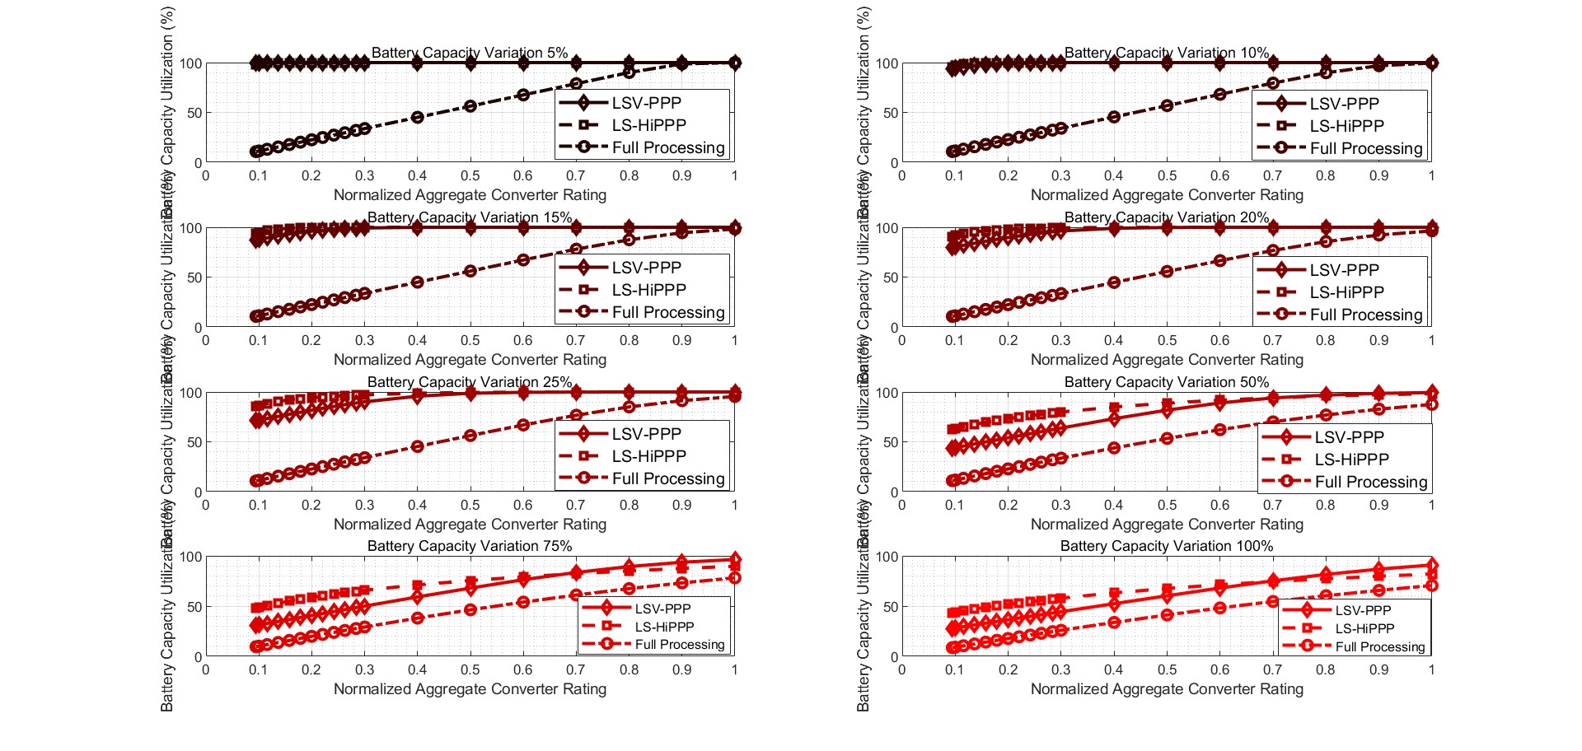
Battery Capacitance Utilization

Slide 4
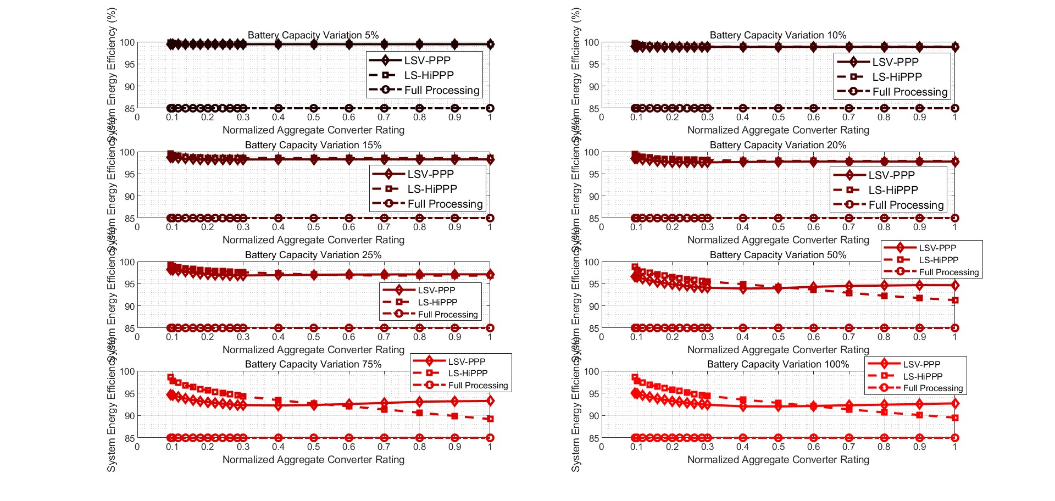
System Energy Efficiency

Slide 5
Detailed Figures
2

Slide 6
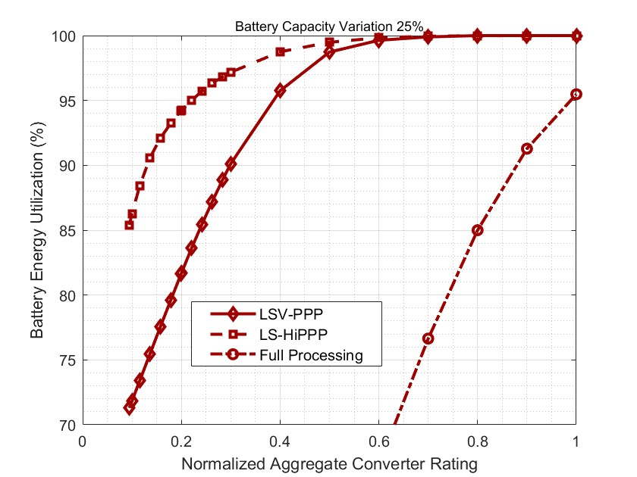
Battery Capacitance Utilization
We can see from the figure left that LS-HiPPP works much better than LSV-PPP and Full Processing when converters process relatively low power. When converter rating increases to 0.6 and higher, the battery energy utilization of LSV-PPP and LS-HiPPP are nearly 100%.

Slide 7
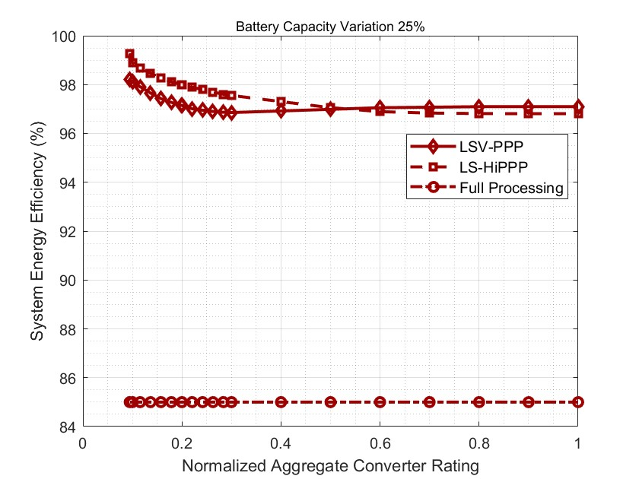
System Energy Efficiency
We can see from the figure left that LS-HiPPP and LSV-PPP performs much better than Full Processing. When converter rating increases to 0.5, the system efficiency of LSV-PPP becomes higher than that of LS-HiPPP.
Analysis of reason: The total processed energy increases to the largest when single converter rating is 0.6 and decreases a little as converter rating increases. With larger converter rating, certain converts process more energy while others process less, which leads to less total processed energy.

Slide 8
Update
3

Slide 9
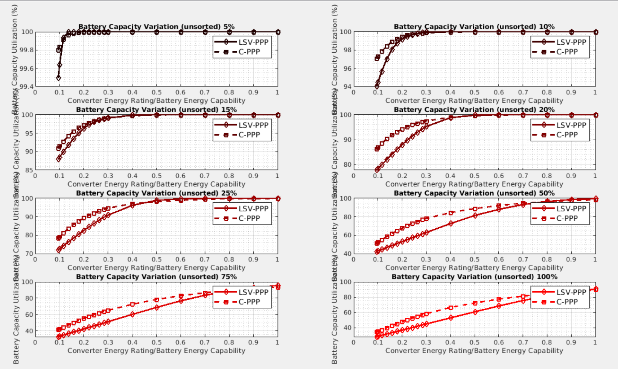
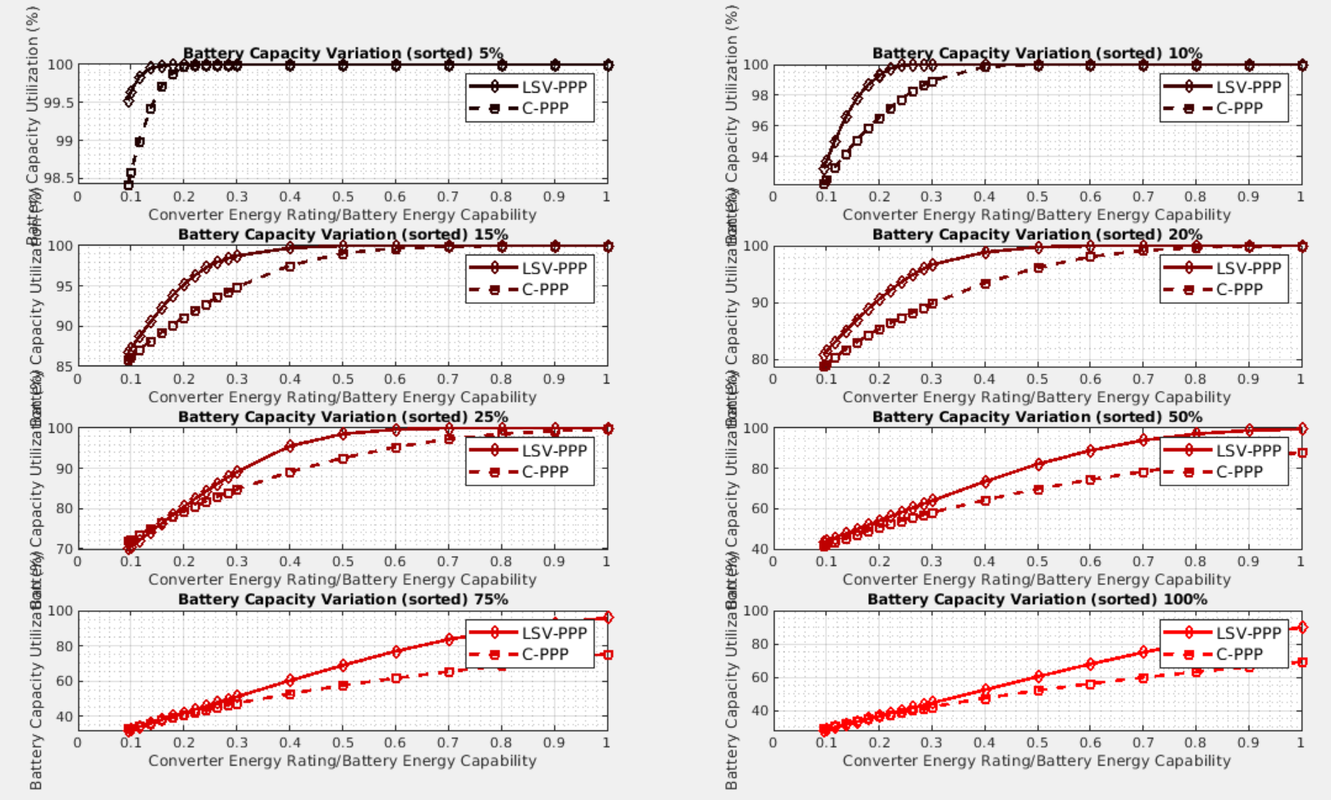
One layer comparison - Battery Utilization (unsorted vs sorted)
C-PPP is better for unsorted bat.
LSV-PPP doesn’t change.

Slide 10
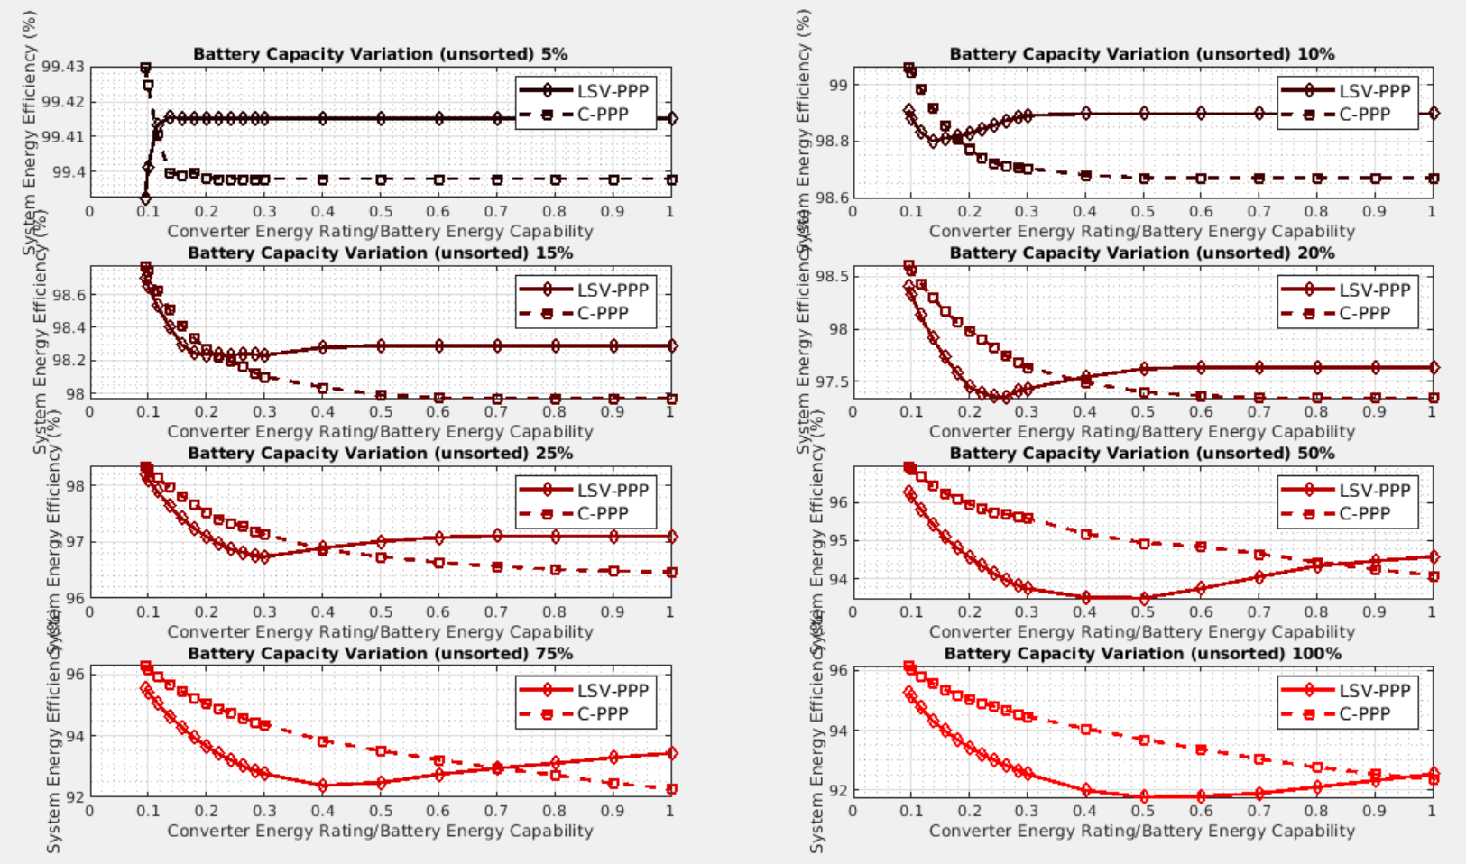
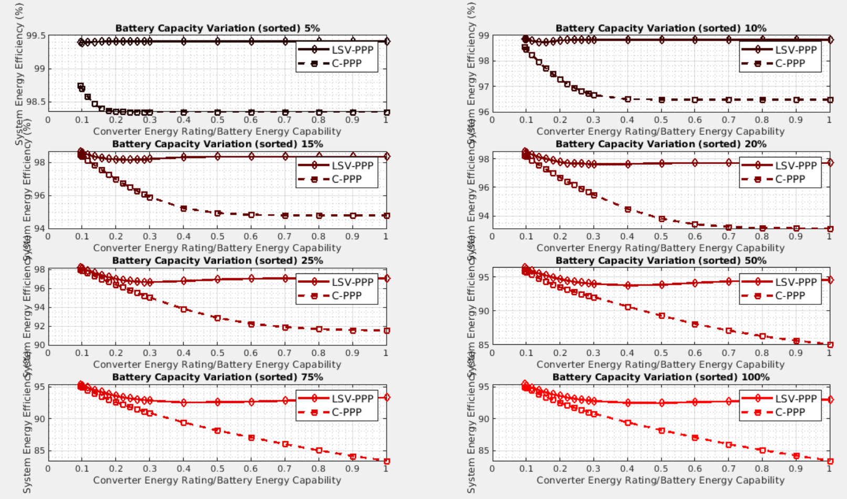
One layer comparison - System Efficiency (unsorted vs sorted)
LSV-PPP does not change much.
But efficiency drops a lot for C-PPP if bats are sorted.
Conclusion: C-PPP more suitable for unsorted bat.

Slide 11
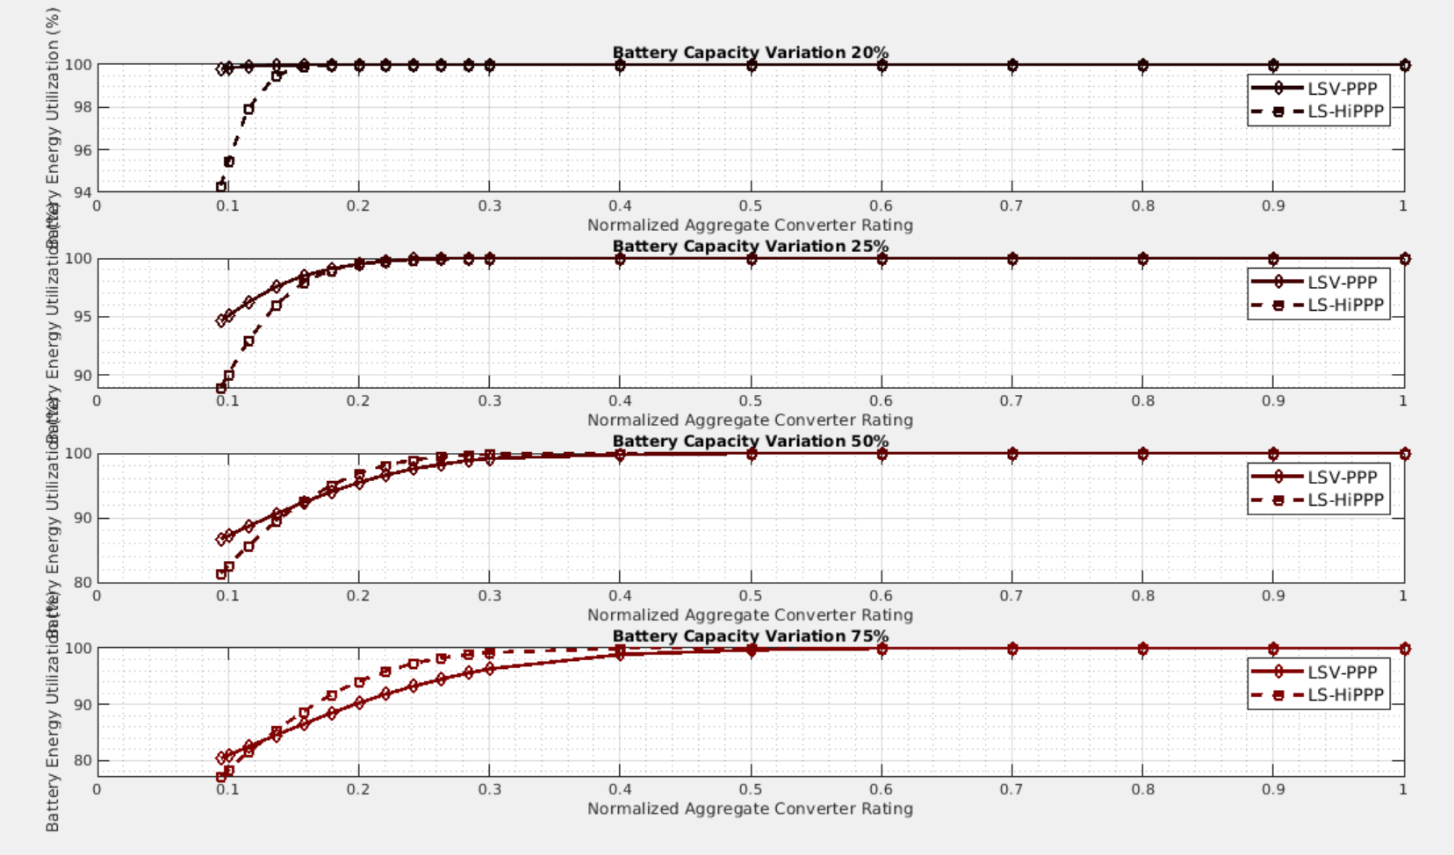
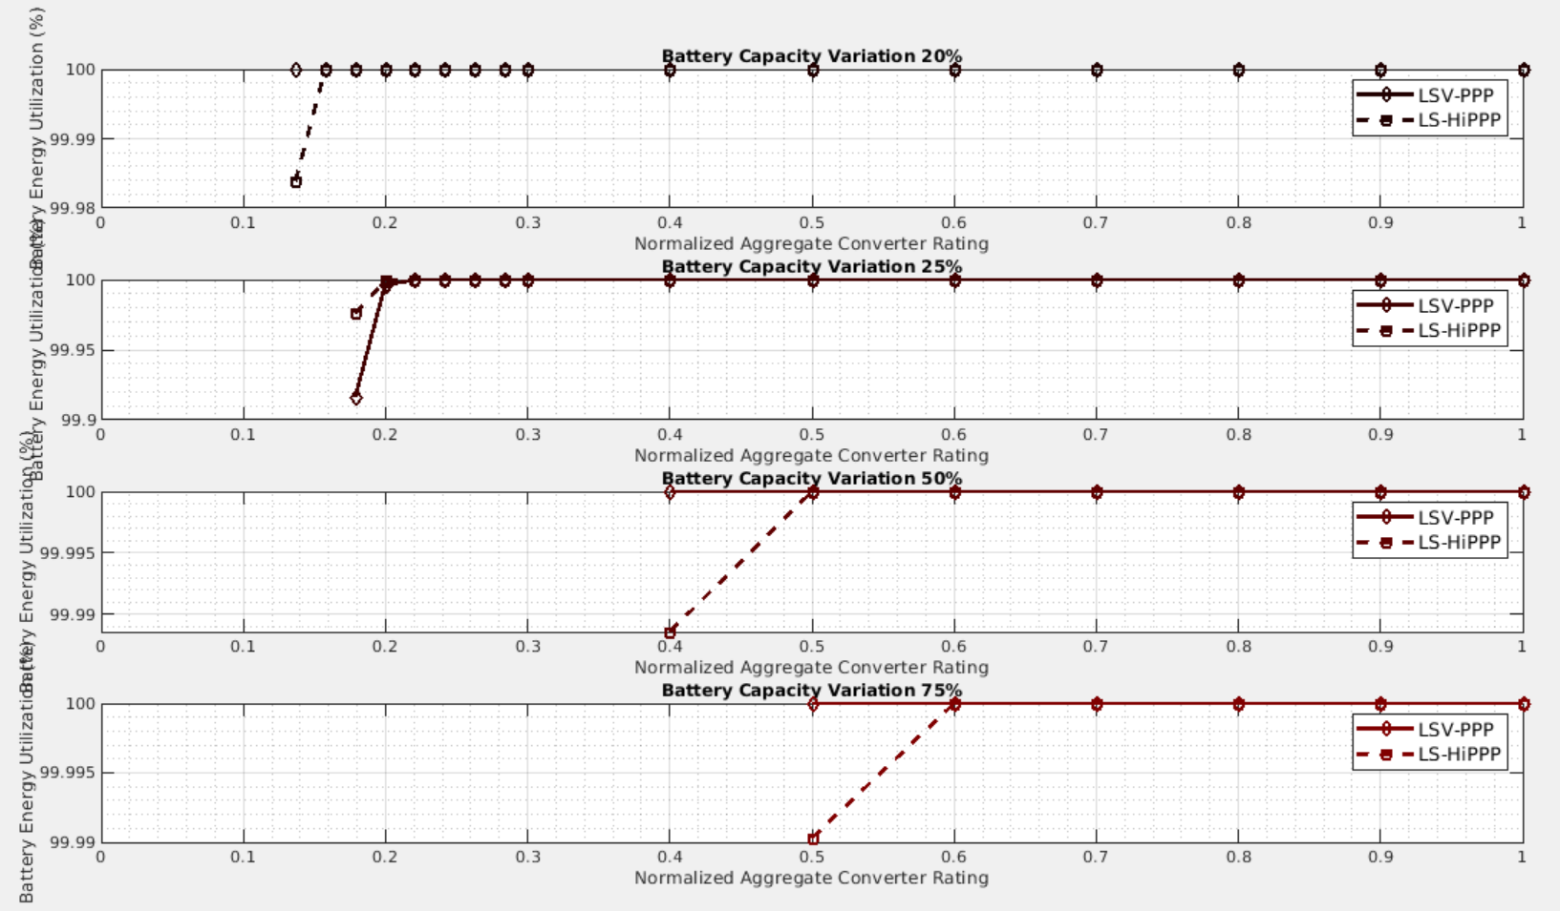
Two layer comparison - Battery Utilization (unsorted vs sorted)
1.When battery variation is small, Virtual Bus performs better. As variation increases, Hi-PPP is better.
2.Sorted batteries perform better for both architectures.

Slide 12
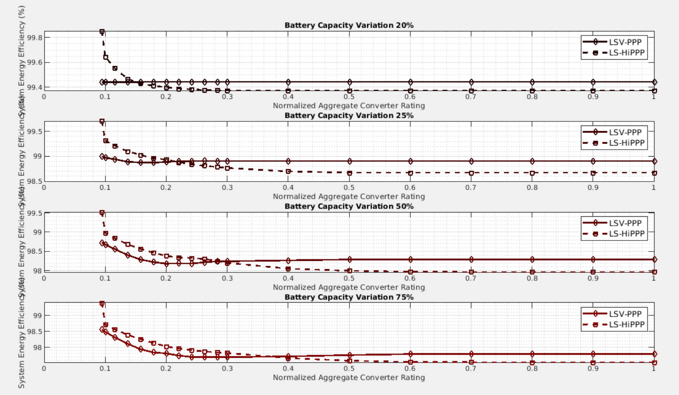
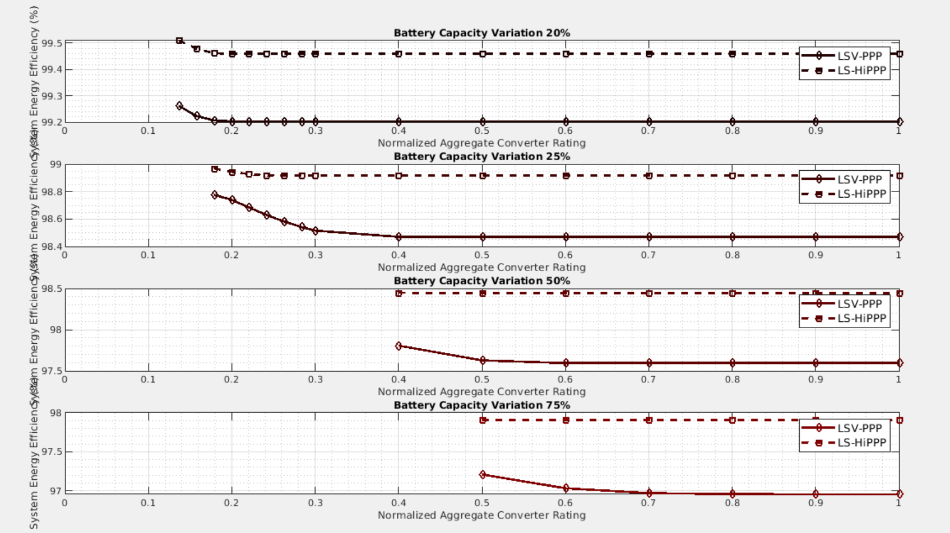
Two layer comparison - System Efficiency (unsorted vs sorted)
1. Efficiency does not differ much for unsorted batteries while Virtual Bus performs a little better.
2.For sorted batteries, HiPPP is more suitable.

Slide 13
At 20% power converter rating
heterogeneity |  | 25% |  |  |  | 50%
 |  | unsorted |  | sorted |  | unsorted |  | sorted
 |  | BU% | SE% | BU% | SE% | BU% | SE% | BU% | SE%
1-layer | CPPP | 89 | 98 | 79 | 96 | 68 | 96 | 50 | 93
 | VPPP | 82 | 97 | 81 | 97 | 53 | 95 | 54 | 95
2-layer | LS-HiPPP | 99 | 99 | 100 | 99 | 97 | 98 | 73 | 97
 | LSV-PPP | 99 | 99 | 100 | 99 | 95 | 98 | N/A | N/A
Summary:
25% unsorted choose-> 2-layer LS-HiPPP/LSV-PPP
Sorted choose-> 2-layer LS-HiPPP/LSV-PPP
50% unsorted choose-> 2-layer LS-HiPPP
Sorted choose-> 2-layer LS-HiPPP BU: battery utilization SE: system efficiency

